Slide 1
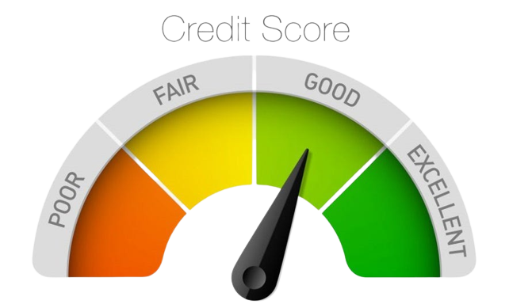
Credit Score Classification
Prepared By: Bipin Shrestha

Slide 2
Introduction to credit score classification
Credit score classification involves categorizing individuals into different credit score classes based on their credit history and other relevant financial information.
These classes typically range from poor to excellent credit.
Lenders use these classes to assess the risk associated with lending to a particular borrower.
The goal of credit score classification with machine learning is to automate and improve this classification process by manipulating historical data and predictive modeling

Slide 3
Why credit score classification is important?
Risk Assessment: It helps lenders assess the creditworthiness of borrowers, enabling them to make informed decisions on loan approvals.
Interest Rates: Determines the interest rates offered to borrowers, lower credit scores may result in higher interest rates.
Financial Inclusion: Facilitates financial inclusion by providing access to credit for individuals with good credit histories.
Credit Access: Affects the ability to obtain various types of credit, such as mortgages, credit cards, and personal loans.
Credit Limits: Influences the credit limits provided to borrowers, impacting their purchasing power.

Slide 4



Tools used

Slide 5


Relation between ML and Credit score classification
Data collection
Feature engineering
Data processing
Machine Learning
Prediction

Slide 6
Libraries Used
Pandas
for data manipulation and analysis.
Matplotlib
for creating static, animated, and interactive visualizations in various formats.
Seaborn
for creating informative and aesthetically pleasing statistical graphics
Scikit-Learn
for implementing various machine learning algorithms and data processing techniques.
NumPy
for numerical and scientific computing
Warning
for providing warning

Slide 7
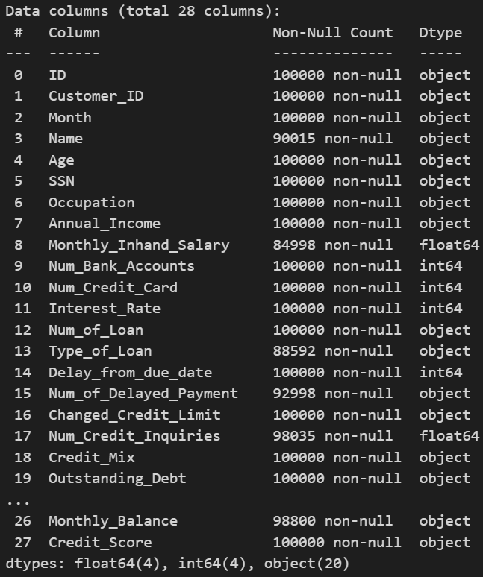
About the dataset
Consists of 100000 samples.
20 columns of object type.
4 columns of float type.
4 columns of numeric type.

Slide 8
Project Workflow
1. Necessary data import
2. Data load
3. EDA
i. Null-values check (rename/fill)
ii. Duplicated Rows (remove)
4. Feature Engineering (To know Importance)
5. Split into independent and dependent features (x, y)
6. Train-Test Split (x_train, x_test, y_train, y_test)
7. Fit the data into algorithm
8. Check the prediction

Slide 9
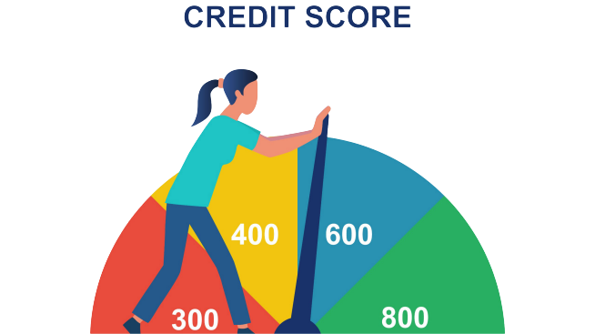
Data preprocessing
Data Transformation
Feature Engineering
Handling Categorical Data
Handling missing data

Slide 10
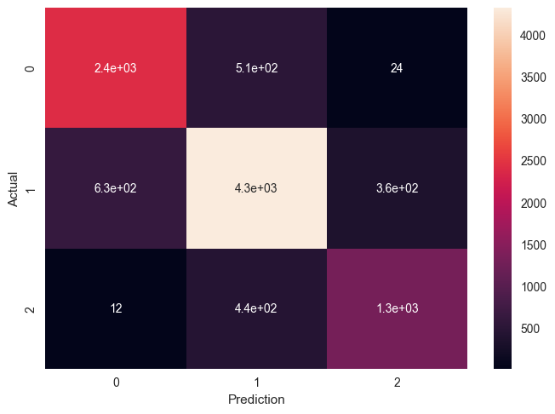
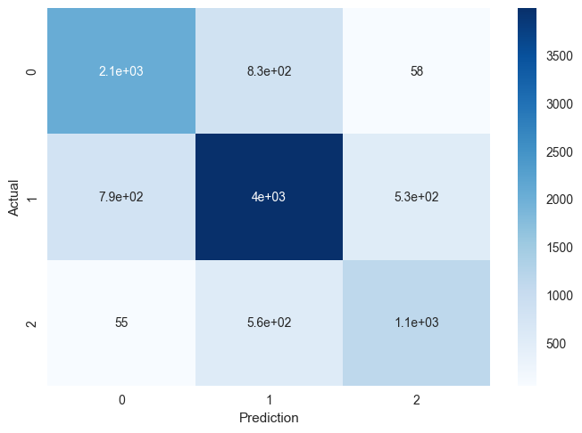
Actual and prediction

Slide 11

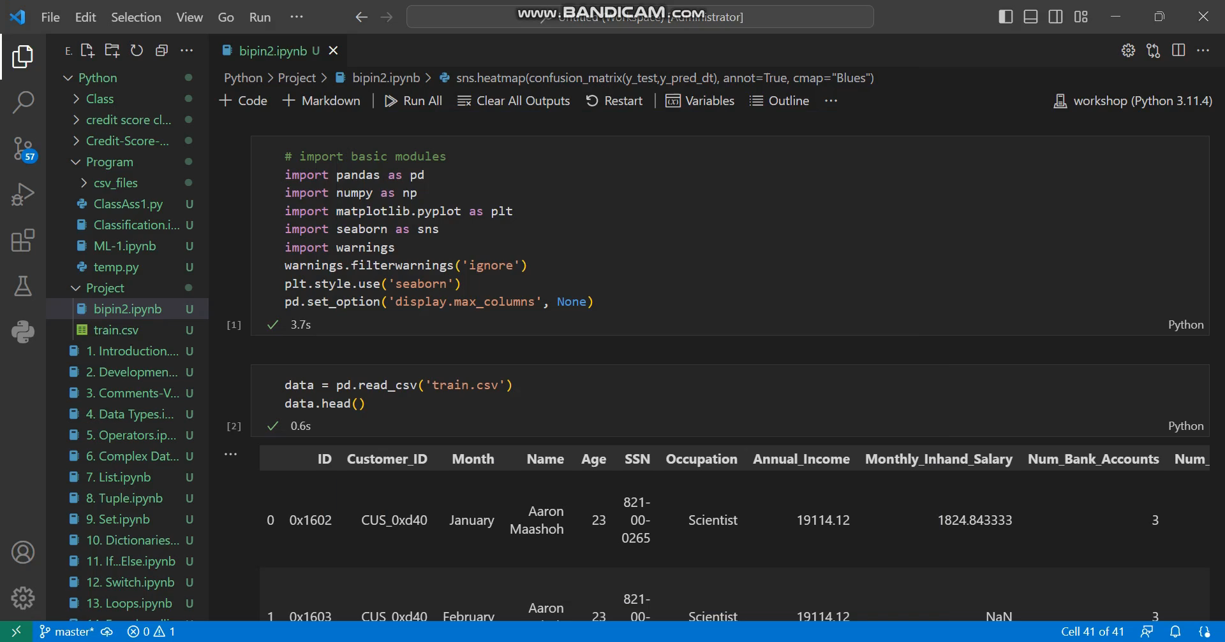
Video Demonstration

Slide 12

Thankyou

